Slide 1


Machine Learning
Electrical Summer Workshops (ESW) 2022
Electrical Engineering Department - Sharif University of Technology
Instructors: Alireza Gargoori Motlagh – Mohammad Mahdi Mirrashid – Ali Nourian

Slide 2
SUPPORT VECTOR MACHINES

Slide 3
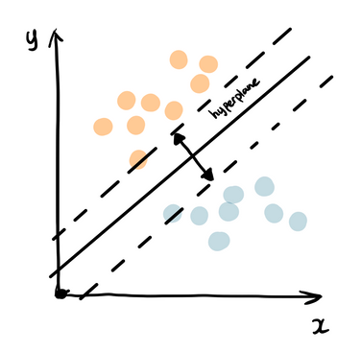
Popular Classification Algorithms
Logistic Regression
Decision Trees and Random Forests
Support Vector Machine (SVM)
KNN
Naïve Bayes
Figure 1. Classification

Slide 4
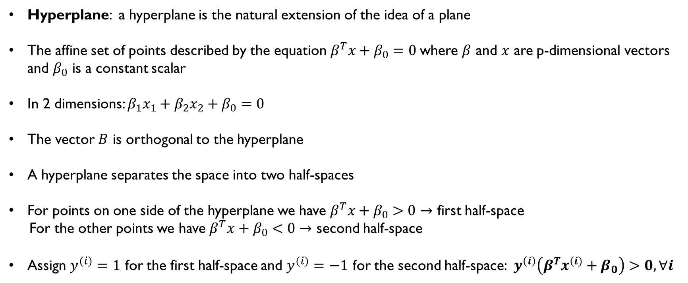
Hyperplanes
Hyperplane: a hyperplane is the natural extension of the idea of a plane
The affine set of points described by the equation $β^{T}x+β_{0}=0$where $β$ and $x$ are p-dimensional vectors and $β_{0}$ is a constant scalar
In 2 dimensions: $β_{1}x_{1}+β_{2}x_{2}+β_{0}=0$
The vector $B$ is orthogonal to the hyperplane
A hyperplane separates the space into two half-spaces
For points on one side of the hyperplane we have $β^{T}x+β_{0}>0→$ first half-space
For the other points we have $β^{T}x+β_{0}<0→$ second half-space
Assign $y^{(i)}=1$ for the first half-space and $y^{(i)}=−1$ for the second half-space: $y^{\left(i\right)}\left(β^{T}x^{(i)}+β_{0}\right)>0, ∀i$

Slide 5
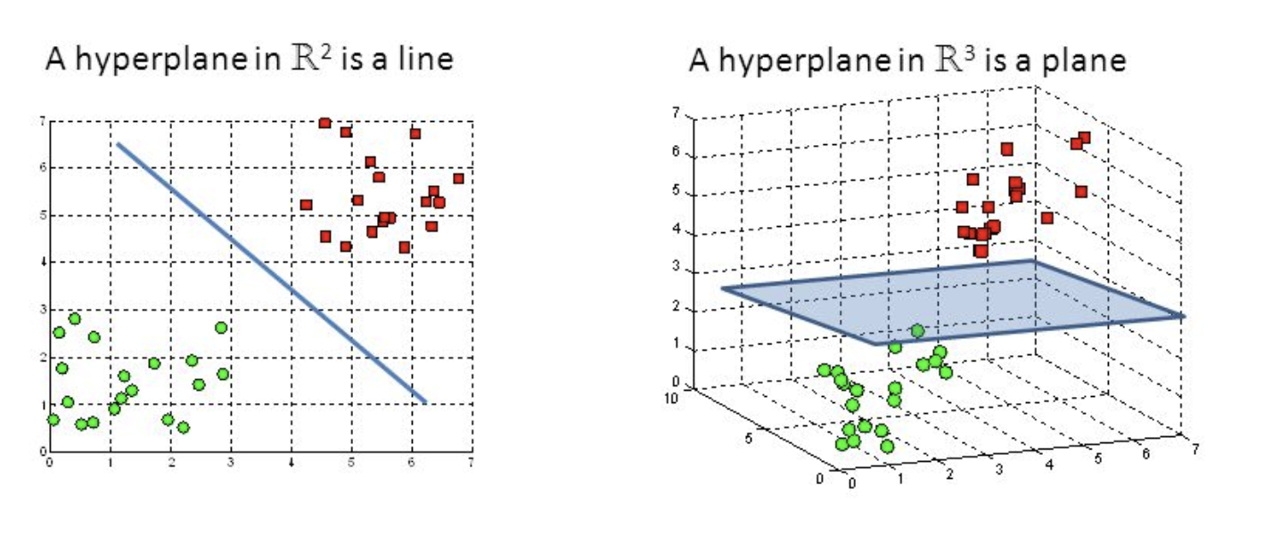
Hyperplanes
Figure 2. Examples of hyperplanes

Slide 6
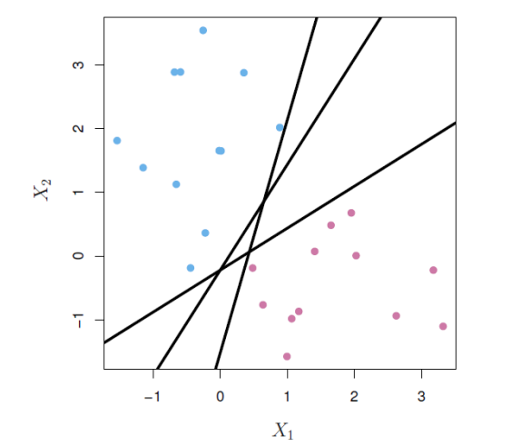
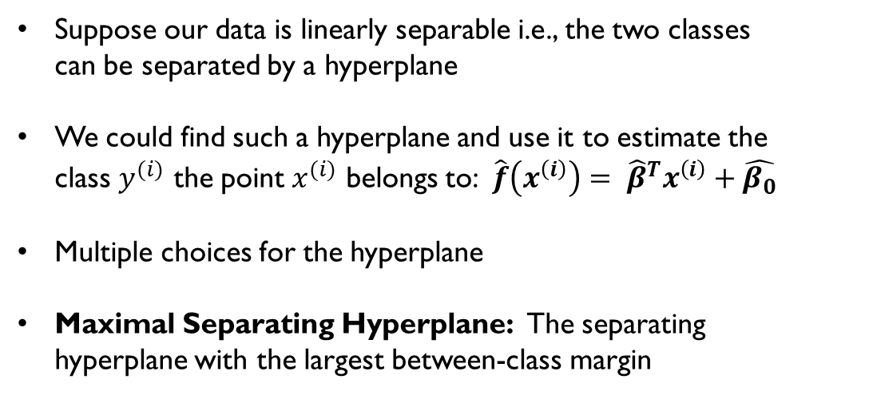
Separating Hyperplanes
Suppose our data is linearly separable i.e., the two classes can be separated by a hyperplane
We could find such a hyperplane and use it to estimate the class $y^{(i)}$ the point $x^{(i)}$ belongs to: $\hat{f}\left(x^{\left(i\right)}\right)= {\hat{β}}^{T}x^{\left(i\right)}+\hat{β_{0}}$
Multiple choices for the hyperplane
Maximal Separating Hyperplane: The separating hyperplane with the largest between-class margin
Figure 3. Multiple separating hyperplanes exist

Slide 7
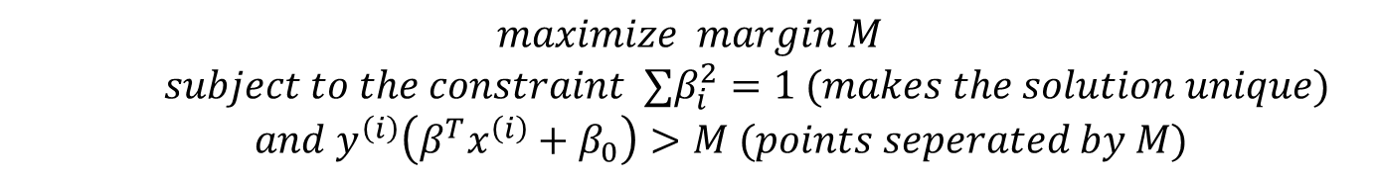
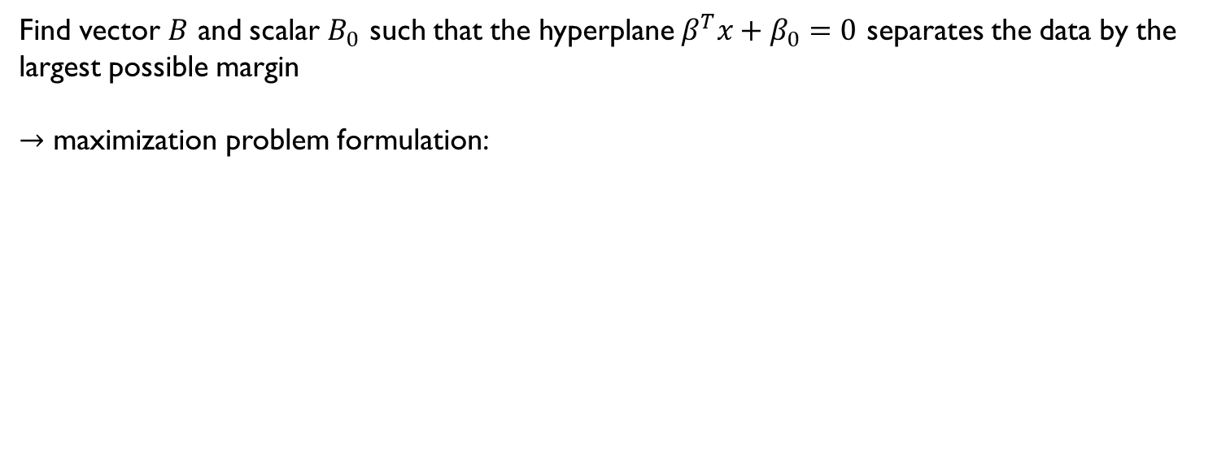
Maximal Separating Hyperplane Problem
Find vector $B$ and scalar $B_{0}$ such that the hyperplane $β^{T}x+β_{0}=0$ separates the data by the largest possible margin
$→$ maximization problem formulation:
$$maximize margin M$$
$subject to the constraint ∑β_{i}^{2}=1 (makes the solution unique)$
$$and y^{\left(i\right)}\left(β^{T}x^{\left(i\right)}+β_{0}\right)>M (points seperated by M)$$

Slide 8
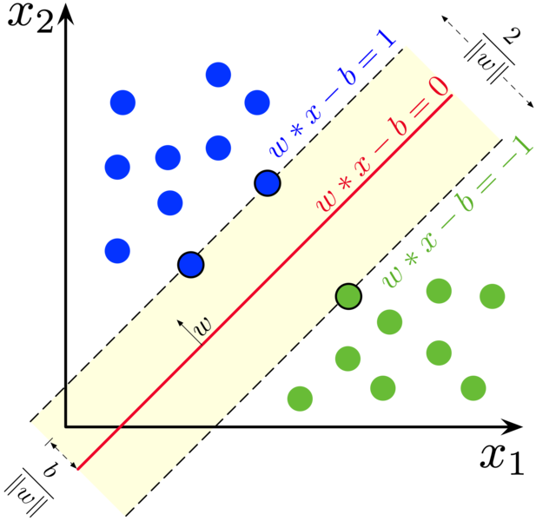
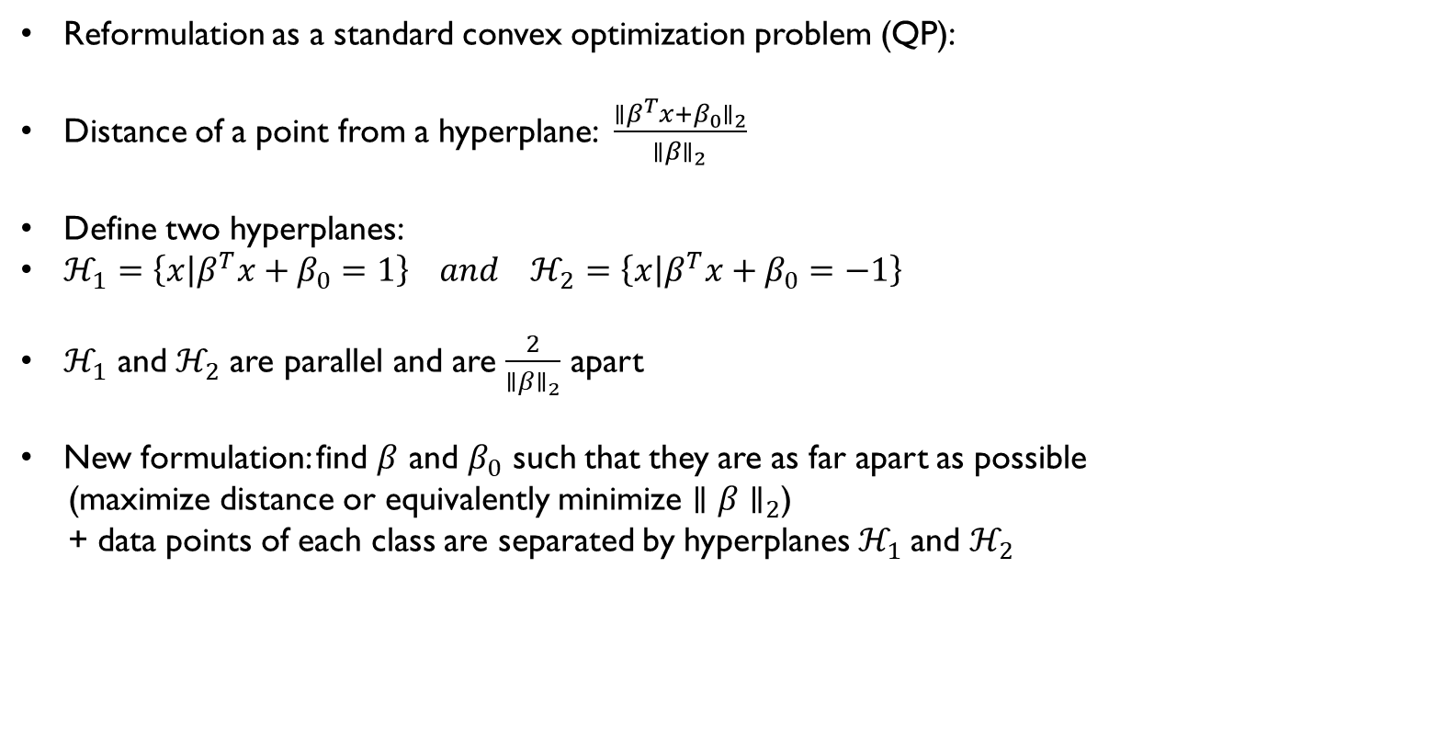
Maximal Separating Hyperplane Problem
Reformulation as a standard convex optimization problem (QP):
Distance of a point from a hyperplane: $\frac{{∥β^{T}x+β_{0}∥}_{2}}{{∥β∥}_{2}}$
Define two hyperplanes:
$ℋ_{1}=\left\{x | β^{T}x+β_{0}=1\right\} and ℋ_{2}=\left\{x | β^{T}x+β_{0}=−1\right\}$
$ℋ_{1}$ and$ℋ_{2}$ are parallel and are $\frac{2}{∥{β∥}_{2}}$ apart
New formulation: find $β$ and $β_{0}$ such that they are as far apart as possible
(maximize distance or equivalently minimize $∥{β∥}_{2}$)
+ data points of each class are separated by hyperplanes $ℋ_{1}$and $ℋ_{2}$
Figure 4. Maximal separating hyperplane

Slide 9
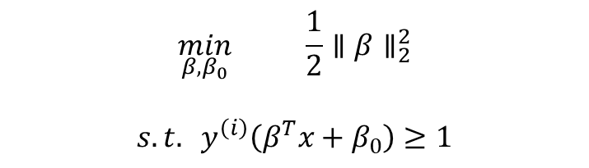
Maximal Separating Hyperplane Problem
$$\min_{β, β_{0}} \frac{1}{2}∥β∥_{2}^{2}$$
$$s.t. y^{\left(i\right)}\left(β^{T}x+β_{0}\right)≥1$$
*The constraint ensures that the data points are separated by both hyperplanes.
Figure 4. Maximal separating hyperplane

Slide 10
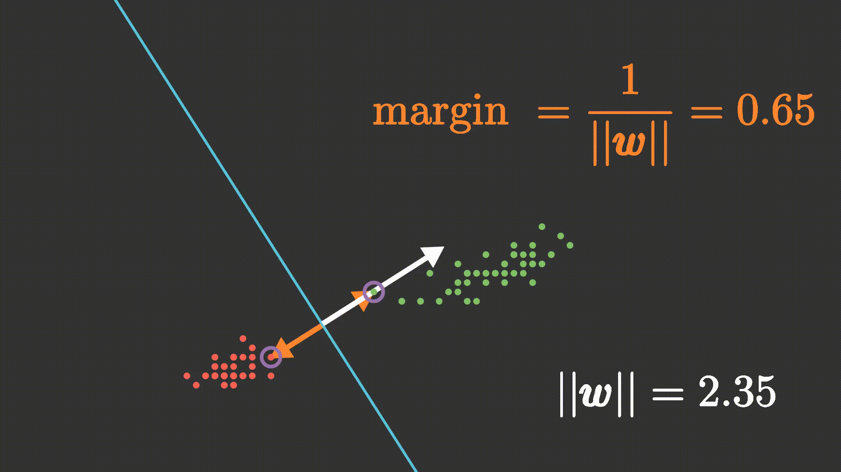
Maximal Separating Hyperplane Problem

Slide 11
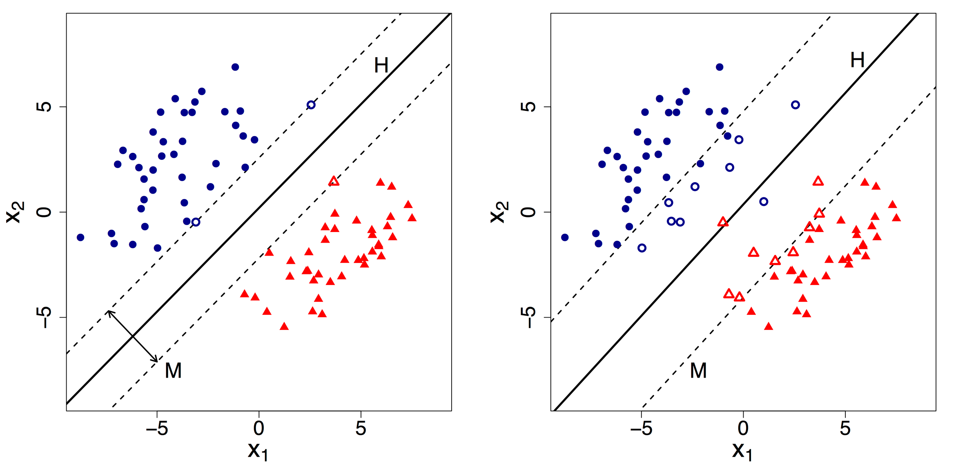
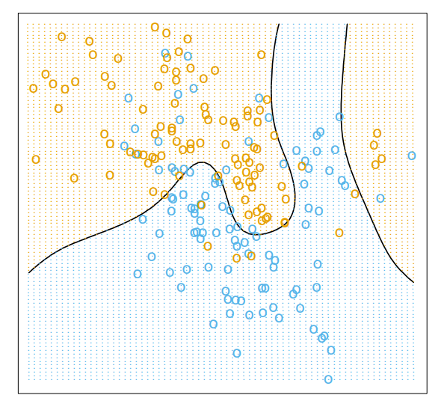
When Data is Not Linearly Separable:
The assumption of data being linearly separable is very optimistic
Introduction of noise can easily make points fall on the wrong side of the hyperplane even when they are initially linearly separable.
The outliers could drastically change the estimated hyperplane
Almost all real-life data are not linearly separable
Figure 5. Linearly separable data
vs “almost” linearly separable data
Figure 6. Non-linear boundaries found by a bayes classifier

Slide 12
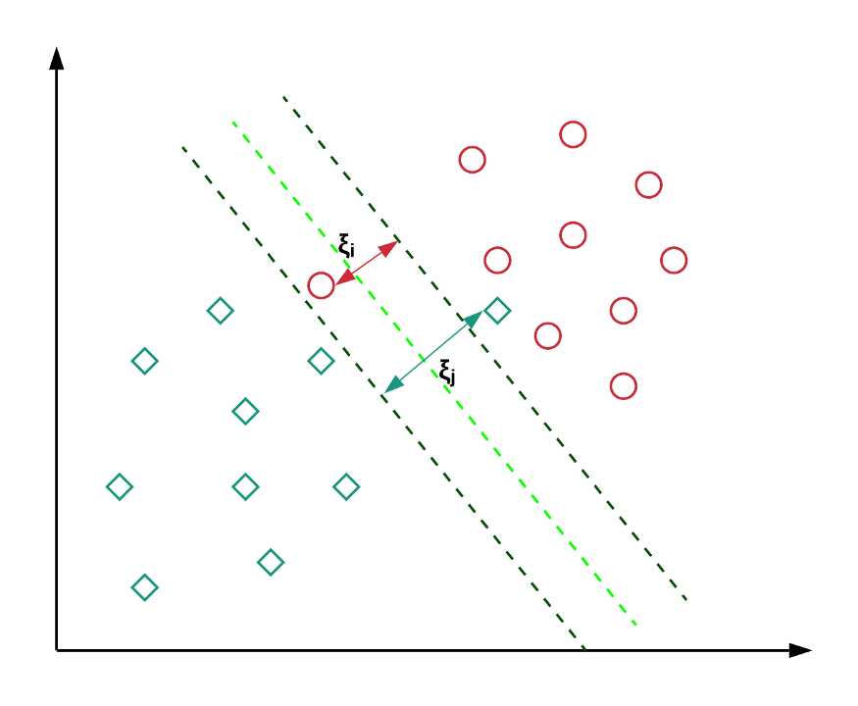
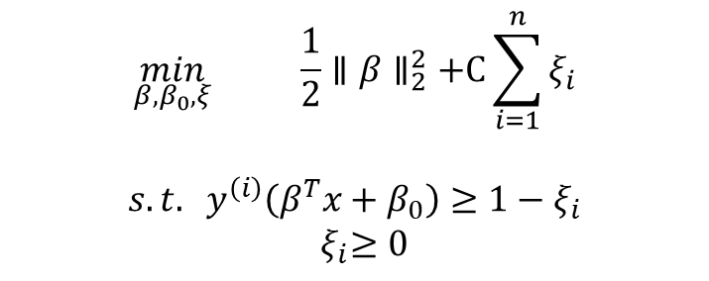
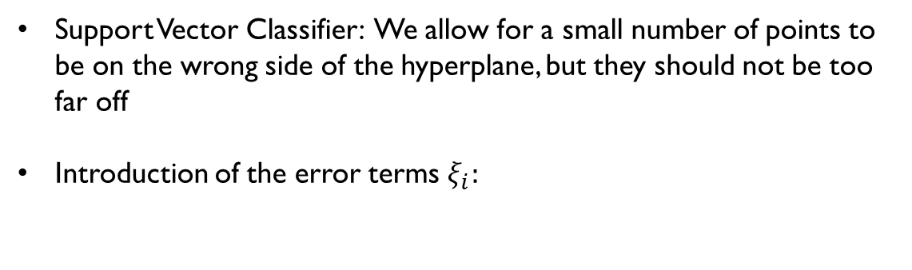
Almost Linearly Separable Data: Soft-Margin
Support Vector Classifier: We allow for a small number of points to be on the wrong side of the hyperplane, but they should not be too far off
Introduction of the error terms $ξ_{i}:$
$$\min_{β, β_{0},ξ} \frac{1}{2}∥β∥_{2}^{2}+C\sum_{i=1}^{n}{ξ_{i}}$$
$$s.t. y^{\left(i\right)}\left(β^{T}x+β_{0}\right)≥1−ξ_{i}$$
${ ξ}_{i}≥0$
Figure 7. Errors of a linear SVC

Slide 13
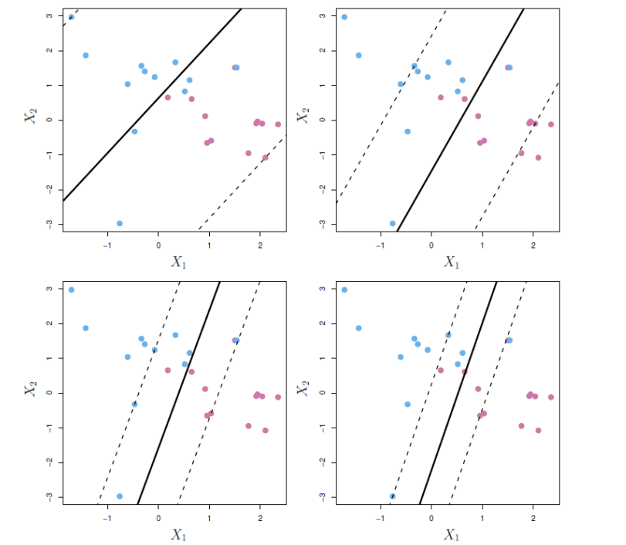
Regularization Term C
The constant term C controls how forgiving we are with errors in the classifier
The right choice of C will allow for enough error to make the estimate robust but not enough to make it unusable (bias-variance trade-off)
Figure 8. Increasing the regularization term C

Slide 14
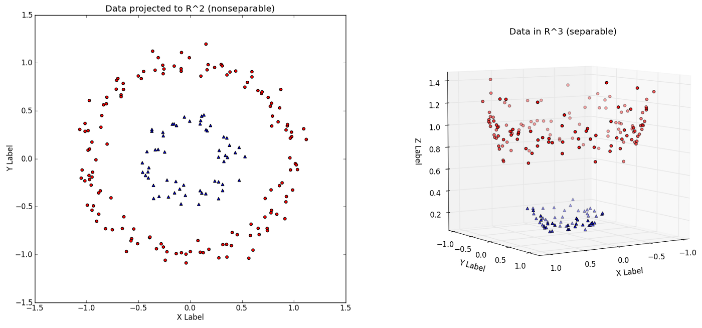
Non-Linearly Separable Data
Feature expansion:
Introduce new features to
data by transforming the original
features
Figure 9. Data is separable in the new enlarged feature space

Slide 15
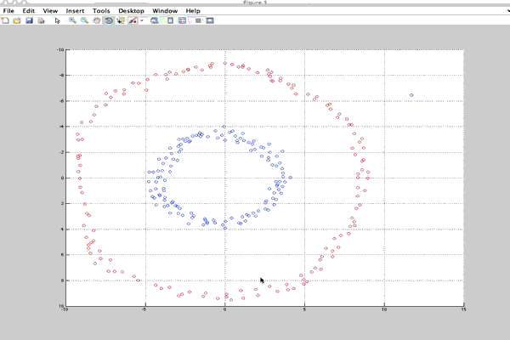
Non-Linearly Separable Data

Slide 16
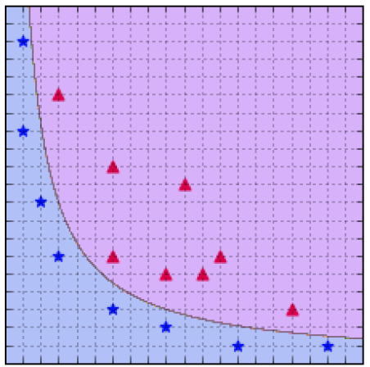
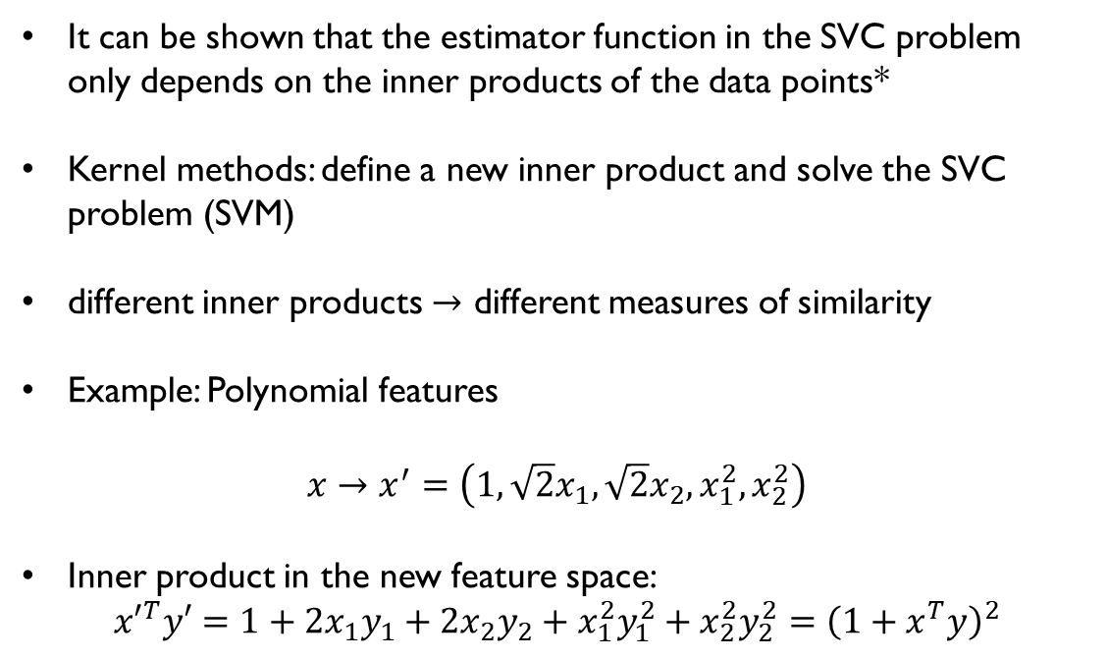
SVM With Kernel Methods
It can be shown that the estimator function in the SVC problem only depends on the inner products of the data points*
Kernel methods: define a new inner product and solve the SVC problem (SVM)
different inner products $→$ different measures of similarity
Example: Polynomial features
$$x→x^{′}=\left(1, \sqrt{2}x_{1}, \sqrt{2}x_{2}, x_{1}^{2}, x_{2}^{2}\right)$$
Inner product in the new feature space:
$${x′}^{T}y′=1+2x_{1}y_{1}+2x_{2}y_{2}+x_{1}^{2}y_{1}^{2}+x_{2}^{2}y_{2}^{2}={\left(1+x^{T}y\right)}^{2}$$
Figure 10. SVM with 2d polynomial kernel

Slide 17
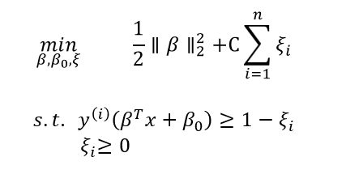
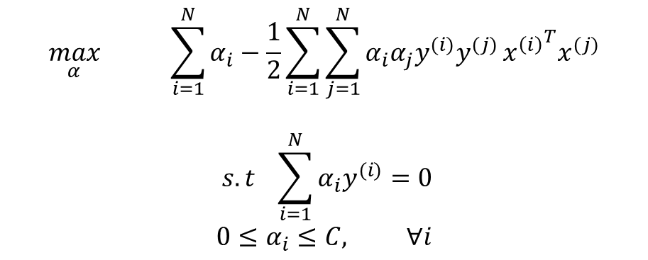
SVM With Kernel Methods
The original optimization problem (primal problem) can be reformulated as another optimization problem (dual problem) using the KKT approach:
$$\max_{α} \sum_{i=1}^{N}{α_{i}−\frac{1}{2}}\sum_{i=1}^{N}{\sum_{j=1}^{N}{α_{i}α_{j}y^{(i)}y^{(j)}}{x^{\left(i\right)}}^{T}x^{(j)}}$$
$$s.t \sum_{i=1}^{N}{α_{i}y^{(i)}}=0$$
$$0≤α_{i}≤C, ∀i$$
$$β=\sum_{i=1}^{N}{α_{i}y^{(i)}}x^{(i)}→\hat{f}\left(x\right)=β^{T}x+β_{0}=\sum_{i=1}^{N}{α_{i}y^{(i)}}x^{T}x^{(i)}+β_{0}$$

Slide 18
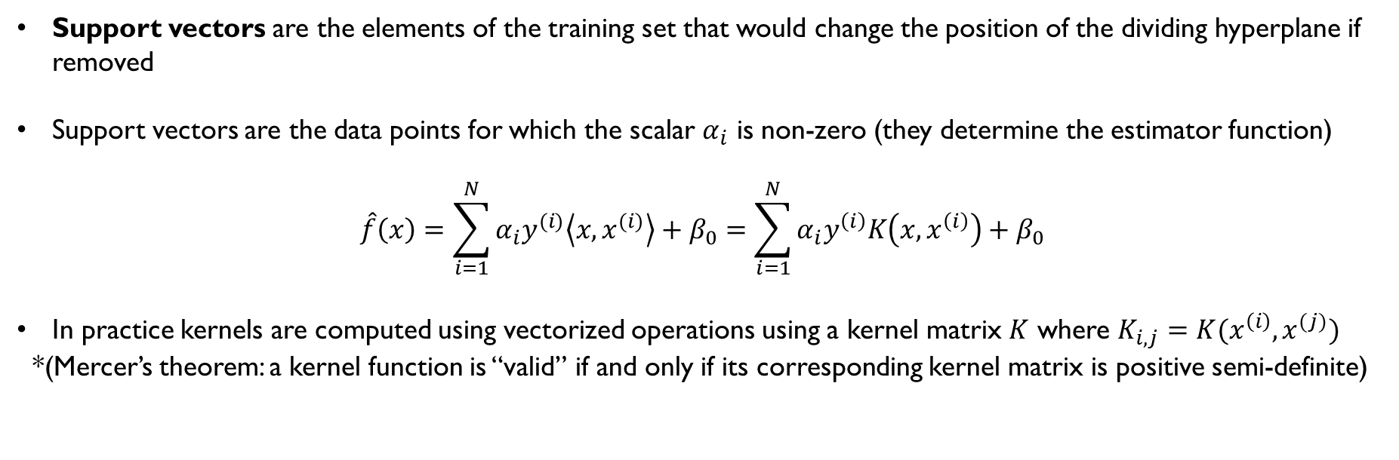
SVM With Kernel Methods
Support vectors are the elements of the training set that would change the position of the dividing hyperplane if removed
Support vectors are the data points for which the scalar $α_{i}$ is non-zero (they determine the estimator function)
$$\hat{f}\left(x\right)=\sum_{i=1}^{N}{α_{i}y^{(i)}\left\langle x, x^{(i)}\right\rangle }+β_{0}=\sum_{i=1}^{N}{α_{i}y^{\left(i\right)}K\left(x,x^{\left(i\right)}\right)+β_{0}}$$
In practice kernels are computed using vectorized operations using a kernel matrix $K$ where $K_{i,j}=K(x^{\left(i\right)},x^{(j)})$
*(Mercer’s theorem: a kernel function is “valid” if and only if its corresponding kernel matrix is positive semi-definite)

Slide 19
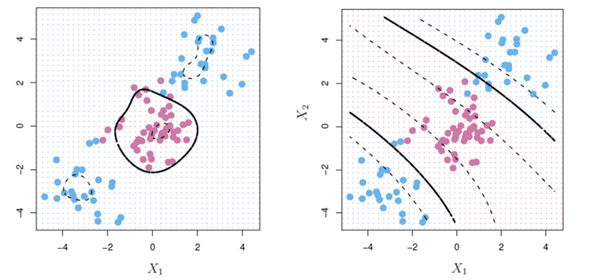
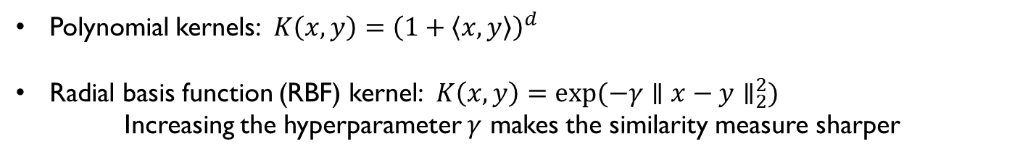
Examples of Kernel Functions
Polynomial kernels: $K\left(x,y\right)={\left(1+\left\langle x,y\right\rangle \right)}^{d}$
Radial basis function (RBF) kernel: $K\left(x,y\right)=exp⁡(−γ∥x−y∥_{2}^{2})$
Increasing the hyperparameter $γ$ makes the similarity measure sharper
Figure 11. Non-linear boundaries using kernels. The left classifier uses an RBF kernel while the one on the right uses polynomial kernel of degree 3

Slide 20
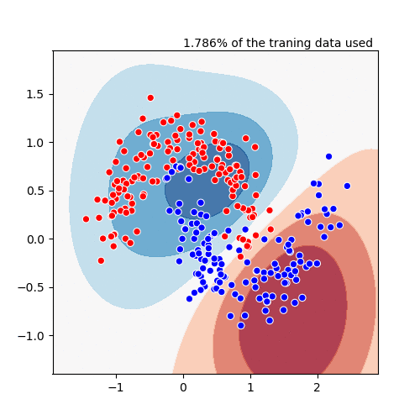
Examples of Kernel Functions

Slide 21
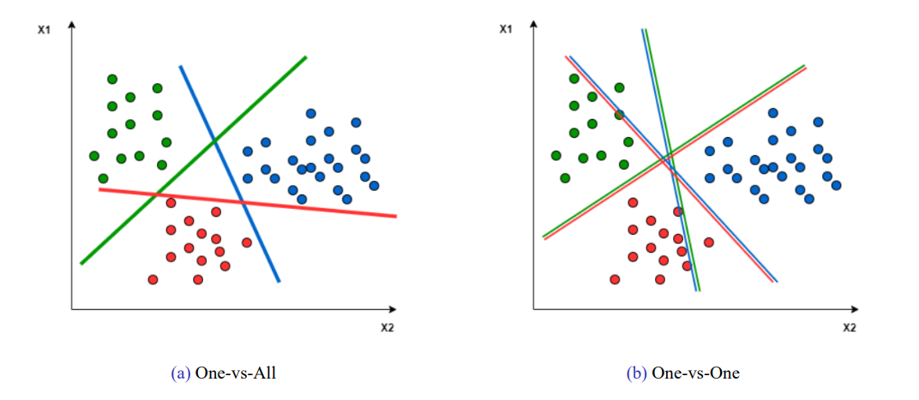
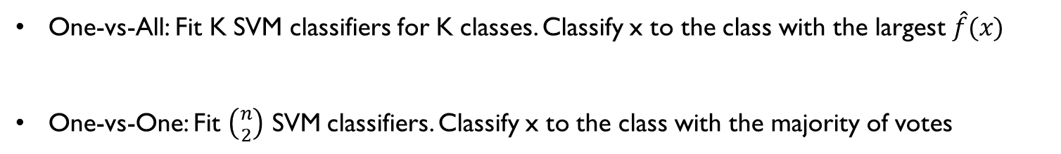
Multi-Class SVM
One-vs-All: Fit K SVM classifiers for K classes. Classify x to the class with the largest $\hat{f}(x)$
One-vs-One: Fit $\left({n \atop 2}\right)$ SVM classifiers. Classify x to the class with the majority of votes
Figure 12. Two approaches for multi-class SVM classification

Slide 22
Performance metrics for classification, Cross-Validation

Slide 23
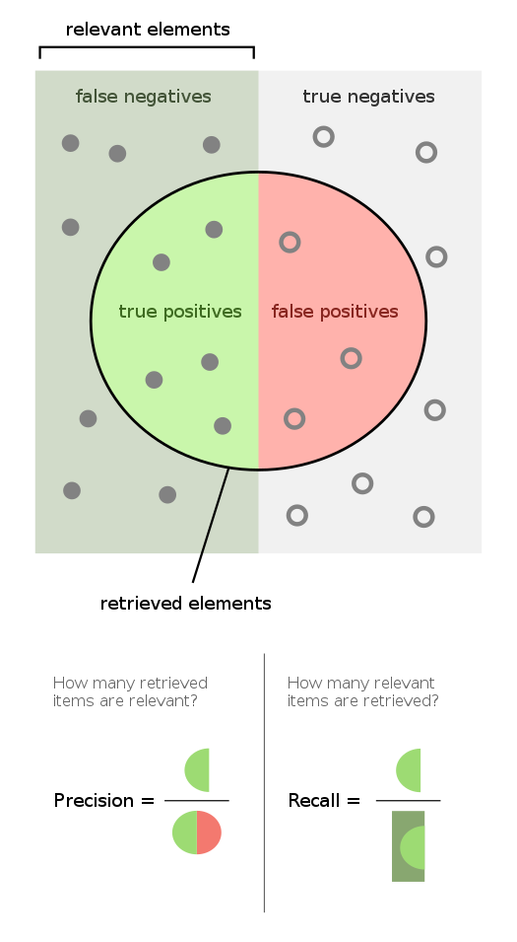
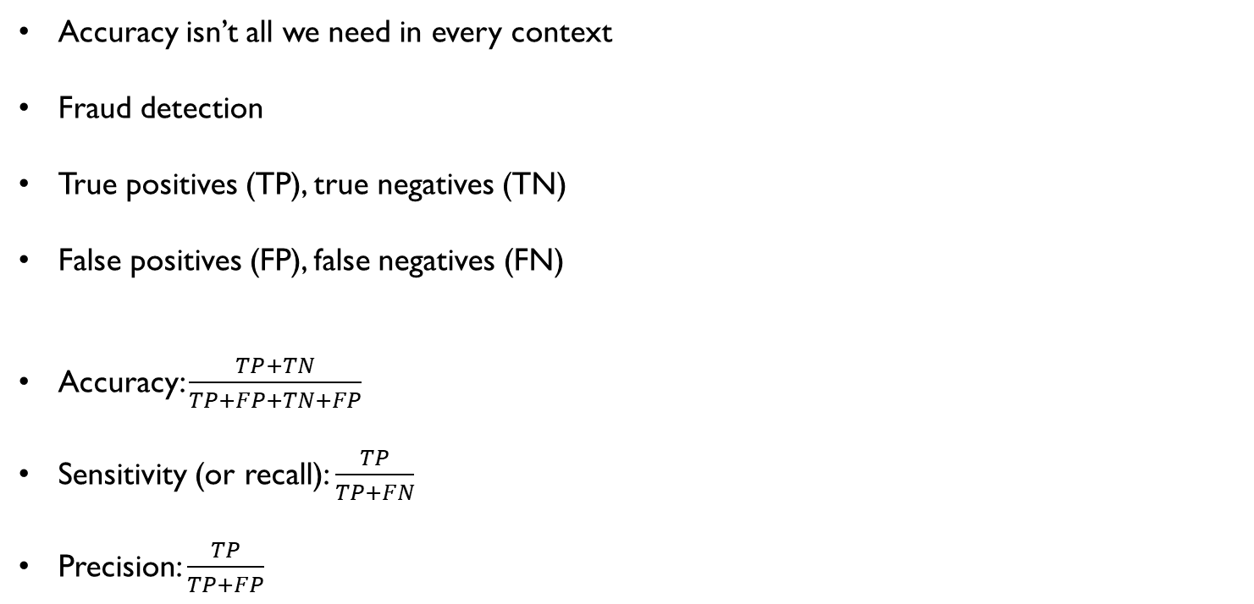
Performance Metrics for Classification
Accuracy isn’t all we need in every context
Fraud detection
True positives (TP), true negatives (TN)
False positives (FP), false negatives (FN)
Accuracy: $\frac{TP+TN}{TP+FP+TN+FP}$
Sensitivity (or recall): $\frac{TP}{TP+FN}$
Precision: $\frac{TP}{TP+FP}$
Figure 13. Precision and recall (or sensitivity) in the context of relevance. Relevant instances are the instances that are positive in reality

Slide 24
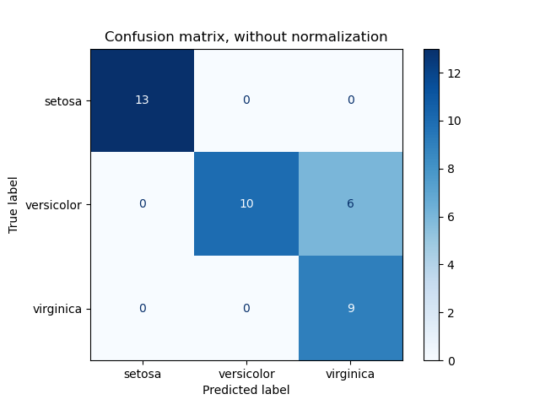
Multiple Classes: Confusion Matrix
Figure 14. Confusion matrix for output of a classifier on the iris dataset (scikit-learn)

Slide 25
Cross-Validation
Estimating the performance of a model
Train, test, validation split
Cross-validation for accurately estimating the model’s performance
Exhaustive cross-validation: Leave-p-out cross validation
Non-exhaustive cross-validation: k-fold cross-validation

Slide 26
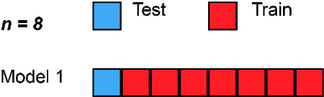
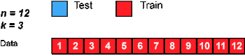
Cross-Validation
Leave-one-out cross-validation
K-fold cross-validation

